Slide 1
CS 201: Data Structures II Unit 02 – Week 02: Array Based Lists
Habib University – Shaping Futures
Faisal Alvi
(For any suggested modifications please email: faisal.alvi@sse.habib.edu.pk)

Slide 2
Unit Outline
ArrayStack – Amortized Analysis ArrayDeque DualArrayDeque Summary
Introduction
ArrayStack – Amortized Analysis
ArrayDeque
DualArrayDeque (Time Permitting)
Summary

Slide 3
ArrayStack – Amortized Analysis
ArrayStack – Amortized Analysis ArrayDeque DualArrayDeque Summary
Let us recall that an ArrayStack presented a list based implementation of a Stack.
The following functions were part of an ArrayStack:
add(i, x), remove(i), resize()
push(x) and pop() can be implemented as add(n, x) and remove(n – 1) respectively.
resize() resizes an array – if the array is full, a new array 2 x the original array is created.
if the array is at least two-thirds empty, a new array half the original array is created.

Slide 4
ArrayStack – Amortized Analysis
ArrayStack – Amortized Analysis ArrayDeque DualArrayDeque Summary
From an earlier course in Data Structures and Algorithms, you have covered:
Best Case, Worst Case, and Average Case Analysis.
Best case analysis evaluates the performance of an algorithm under the assumption that it operates on the most favorable input, providing an optimistic perspective on its efficiency.
Worst case analysis assesses the performance of an algorithm based on the input that results in the maximum execution time.
Average case analysis in algorithm design and analysis evaluates the expected performance of an algorithm by considering the average behavior over all possible inputs, providing a more realistic estimate of its efficiency.

Slide 5
Amortized Analysis
ArrayStack – Amortized Analysis ArrayDeque DualArrayDeque Summary
Amortized analysis for a selected data structure evaluates the average cost per operation over a sequence of operations.
Although individual operations may have varying costs, amortized analysis is used to provide a more accurate and balanced assessment.
This is particularly useful in cases where some operations may be more expensive than others.
Example: Multipop(k) operation in a stack. This pops ‘k’ elements off the stack.
Although its time complexity is O(k), it must be preceded by at least k push operations, resulting in an overall O(1) complexity per operation.

Slide 6
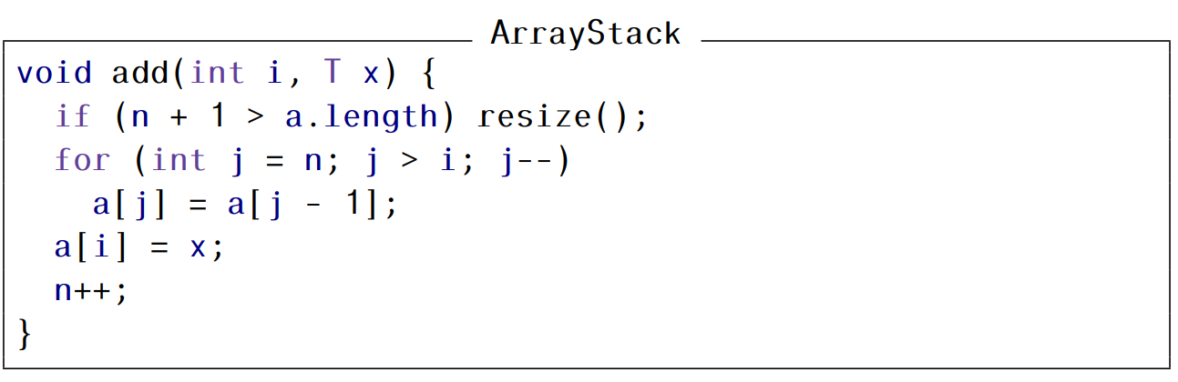
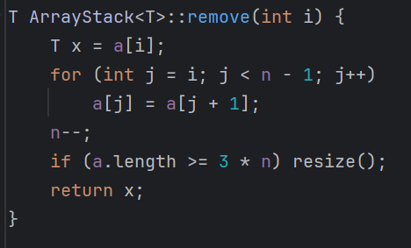
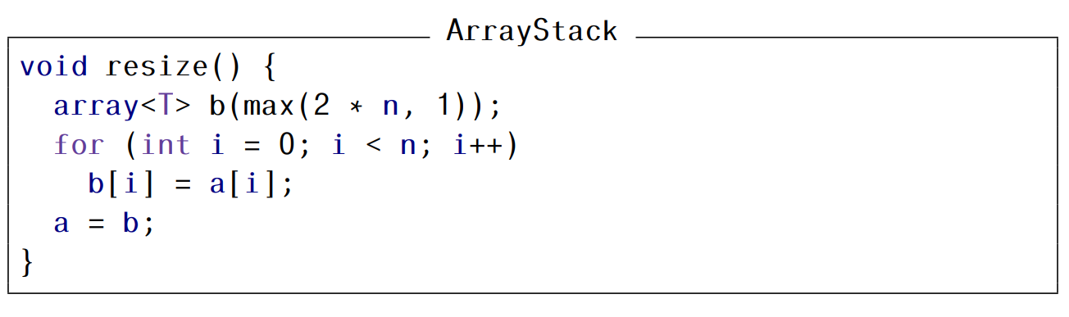
ArrayStack – Amortized Analysis
ArrayStack – Amortized Analysis ArrayDeque DualArrayDeque Summary
Recall the add, remove and resize operations:

Slide 7
ArrayStack – Amortized Analysis
ArrayStack – Amortized Analysis ArrayDeque DualArrayDeque Summary
From the preceding code, we see that the worst case time complexity of the resize() operation is O(n).
If we include the call to resize() within the add() and remove() operations, the worst case time complexity of each one of these operations is also O(n).
Suppose we begin with an empty ArrayStack, and using m ≥ 1 calls to add() and remove, we want to create our required stack.
The call sequence could be: add(), add(), remove(), add() … (m calls)
Apparently the worst case time complexity of these operations will be O(mn).
In particular, for m = n, this is O(n²) – a pessimistic (and incorrect) estimate.

Slide 8

ArrayStack – Amortized Analysis
ArrayStack – Amortized Analysis ArrayDeque DualArrayDeque Summary
Before giving the formal proof, we note that resize() is not called with each call to add() or remove().
Infact, preceding each call to resize(), at least n / 2 – 1 calls have been made to add() or remove(), where n is the size of the stack.

Slide 9
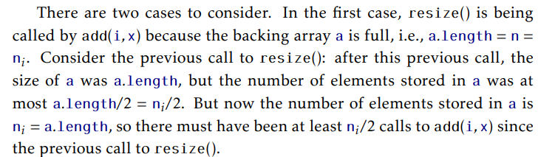
ArrayStack – Amortized Analysis
ArrayStack – Amortized Analysis ArrayDeque DualArrayDeque Summary
Proof: First, we will prove that any call to resize() requires at least n / 2 – 1 calls to add or remove.

Slide 10
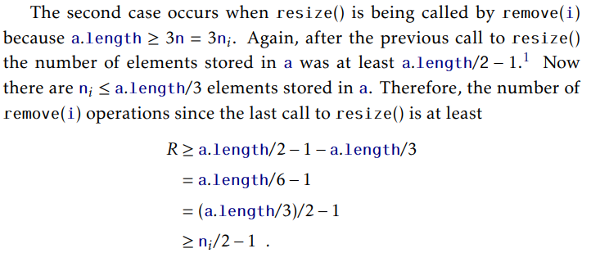
ArrayStack – Amortized Analysis
ArrayStack – Amortized Analysis ArrayDeque DualArrayDeque Summary
Proof (Continued):

Slide 11
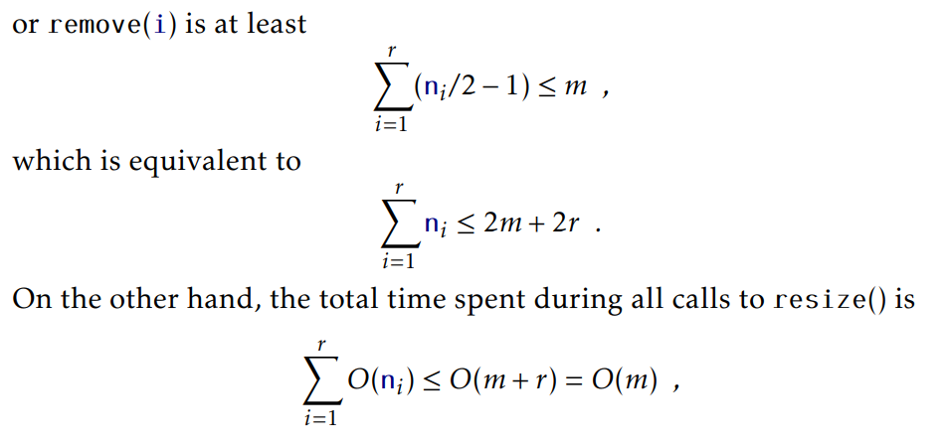
ArrayStack – Amortized Analysis
ArrayStack – Amortized Analysis ArrayDeque DualArrayDeque Summary
Proof (Continued):
Since the total number of calls to add() or remove is at least n / 2 – 1, therefore,

Slide 12
ArrayDeque
ArrayStack – Amortized Analysis ArrayDeque DualArrayDeque Summary
The ArrayDeque is a generalization of both the ArrayStack and the ArrayQueue.
ArrayDeque allows us to efficiently add and retrieve elements from both sides of the List.
This uses the same circular array technique as that used for ArrayQueue.

Slide 13
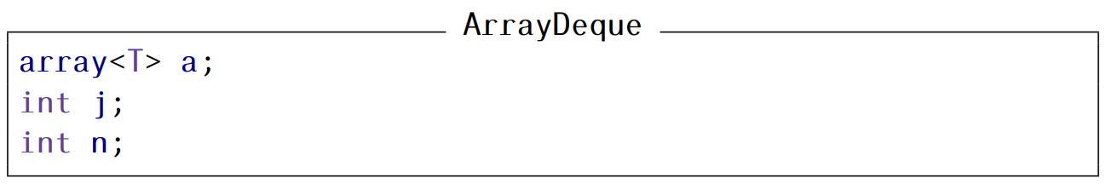
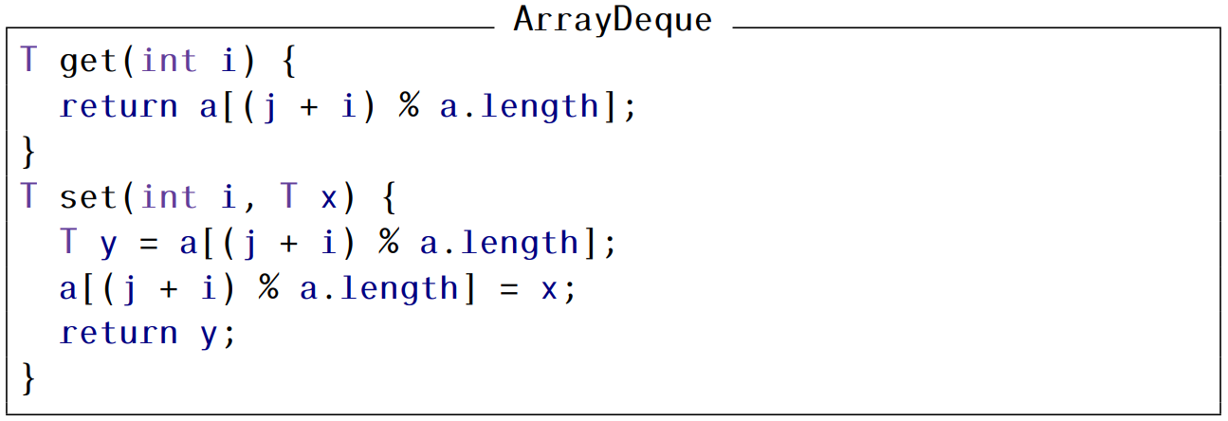
ArrayDeque
ArrayStack – Amortized Analysis ArrayDeque DualArrayDeque Summary

Slide 14
ArrayDeque add
ArrayStack – Amortized Analysis ArrayDeque DualArrayDeque Summary
To make add more efficient, we check if i < n/2.
If so, we shift the elements a[0], ... , a[i − 1] left by one position.
Otherwise (i ≥ n / 2), we shift the elements a[i], ... , a[n − 1] right by one position.
See illustration.
We guarantee that add(i, x) never has to shift more than min{i, n − i} elements.
The running time of the add(i, x) operation (ignoring the cost of a resize() operation) is O(1 + min{i, n − i})

Slide 15
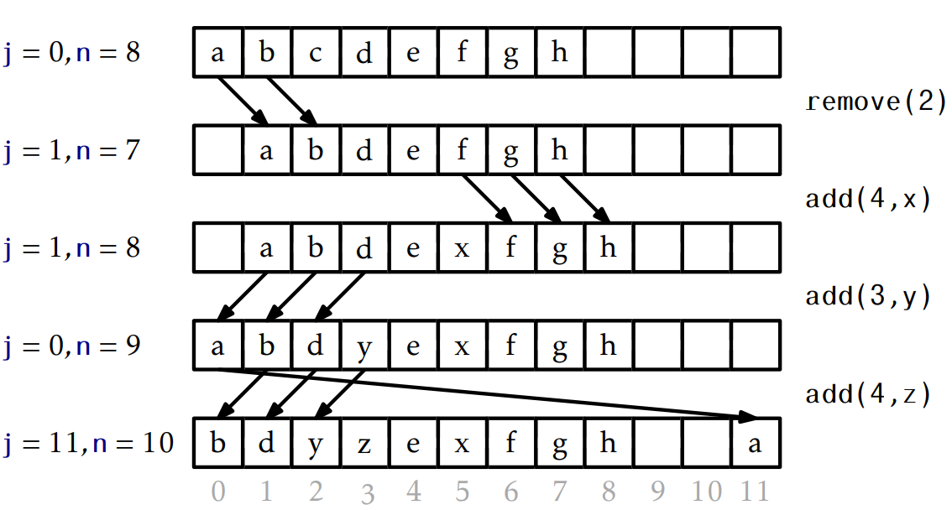
ArrayDeque Examples
ArrayStack – Amortized Analysis ArrayDeque DualArrayDeque Summary

Slide 16
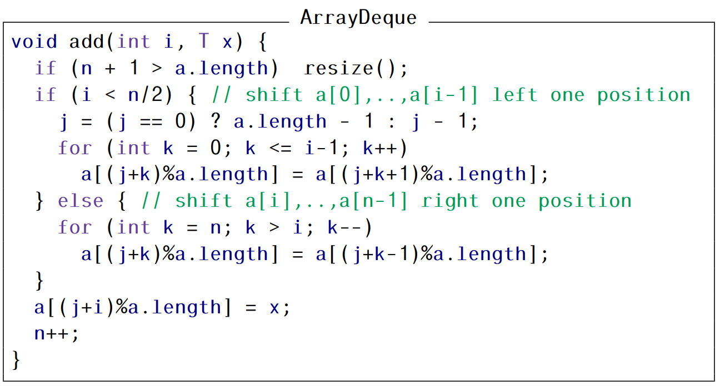
ArrayDeque add
ArrayStack – Amortized Analysis ArrayDeque DualArrayDeque Summary

Slide 17
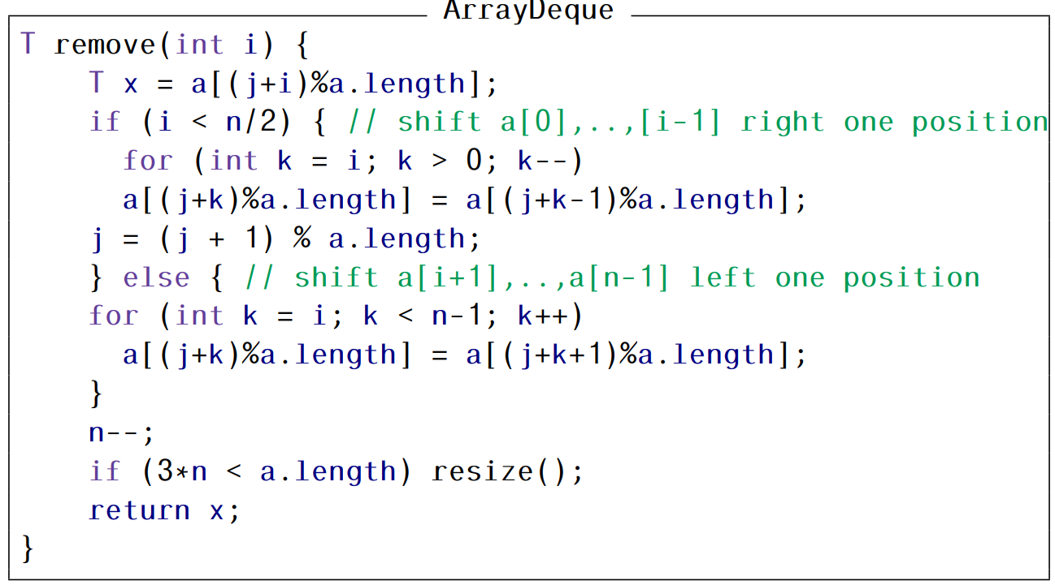
ArrayDeque remove: Similar implementation
ArrayStack – Amortized Analysis ArrayDeque DualArrayDeque Summary

Slide 18
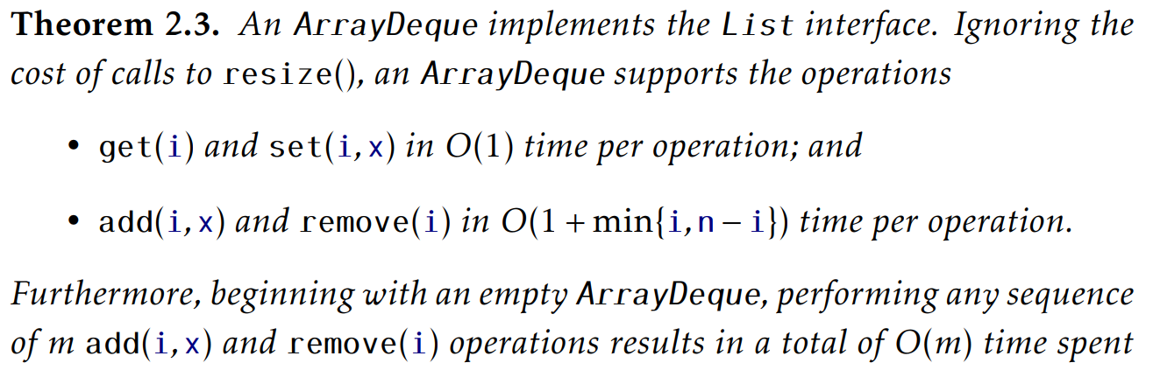
ArrayDeque: Summary
ArrayStack – Amortized Analysis ArrayDeque DualArrayDeque Summary

Slide 19
Dual Array Deque
ArrayStack – Amortized Analysis ArrayDeque DualArrayDeque Summary
Example of a data structure composed of two simpler data structures.
A DualArrayDeque represents a list using two ArrayStacks.
Recall that an ArrayStack is fast when the operations on it modify elements near the end.
A DualArrayDeque places two ArrayStacks, called front and back, back-to-back so that operations are fast at either end.

Slide 20
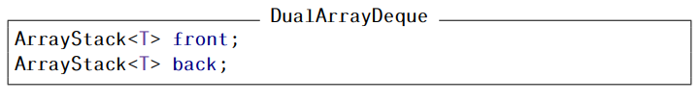
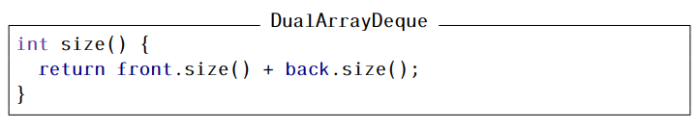
Dual Array Deque
ArrayStack – Amortized Analysis ArrayDeque DualArrayDeque Summary

Slide 21
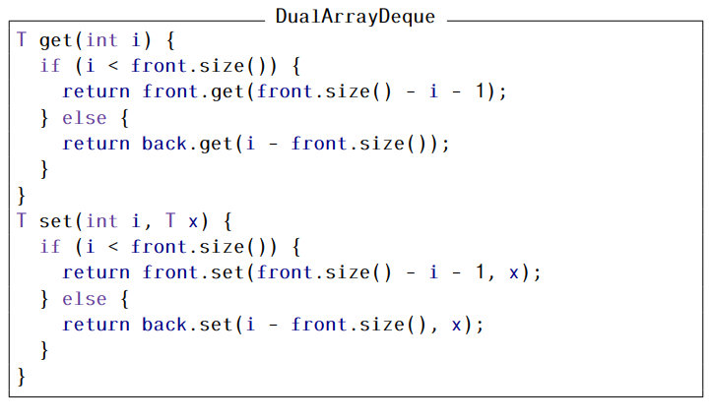
Dual Array Deque
ArrayStack – Amortized Analysis ArrayDeque DualArrayDeque Summary

Slide 22
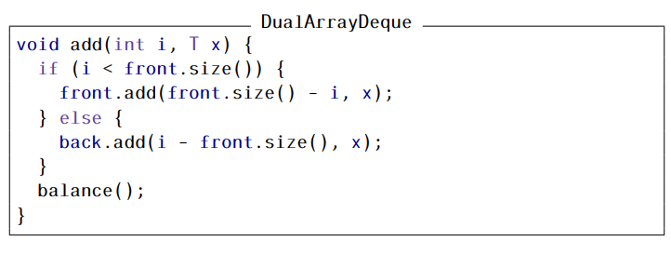
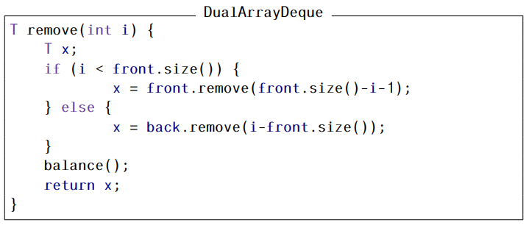
Dual Array Deque
ArrayStack – Amortized Analysis ArrayDeque DualArrayDeque Summary

Slide 23
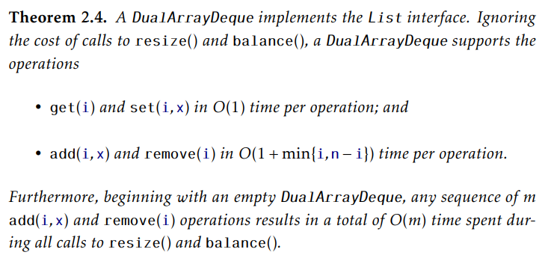
Dual Array Deque: Summary
ArrayStack – Amortized Analysis ArrayDeque DualArrayDeque Summary

